Slide 1

StockSmart
Midterm Presentation

Slide 2

Presentation Outline
Proposal Submission to Midterm Progress
Demo
Midterm Presentation to Final Presentation

Slide 3
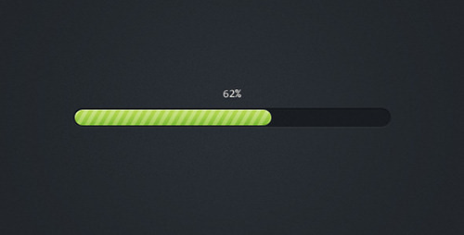
Progress
Project distribution via GitHub Projects
Creation of HTML, CSS pages, and some JS functionality
Rough plan of how to organize the various database tables

Slide 4


Demo

Slide 5

Midterm Presentation to Final Presentation
Set up the databases for the users, friend groups, groceries, food groups, and donation locations.
Fix bugs in the Javascript ( warning, success messages, etc.)
Create user profile and group profile pages

Slide 6
QUESTIONS?

